Slide 1
RC Car Controlled With Hand Motion

Slide 2
Table of contents
01
02
03
04
Components
Circuit Diagram
Code
Git Hub

Slide 3
Components

Slide 4
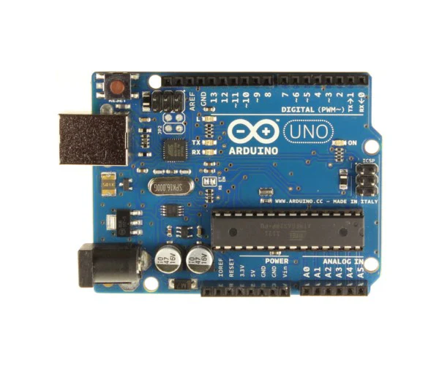
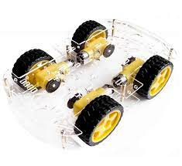
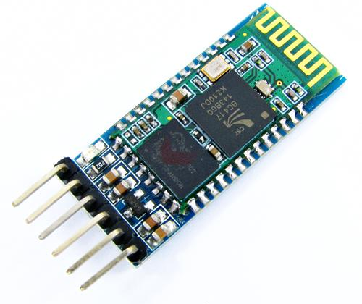
RC car components
Arduino UNO
RC car kit
Bluetooth module HC05

Slide 5
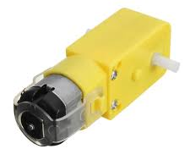
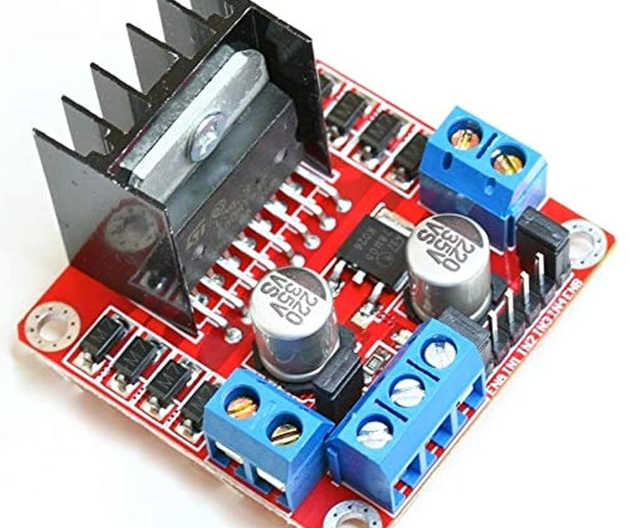
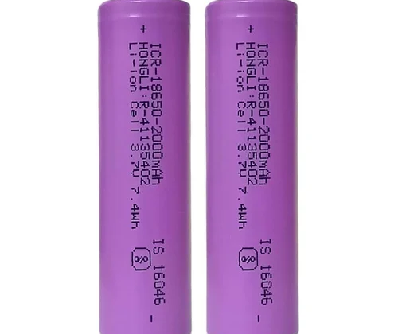
RC car components
Motor
Motor driver L298N
3.7 volt battery x3

Slide 6
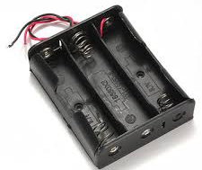
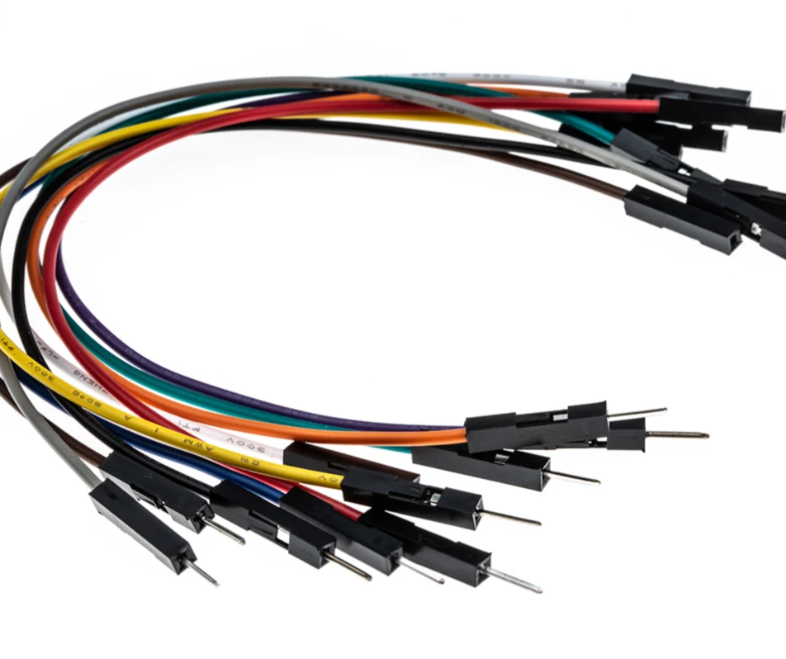
RC car components
Battery Holder
Jumper Wires

Slide 7
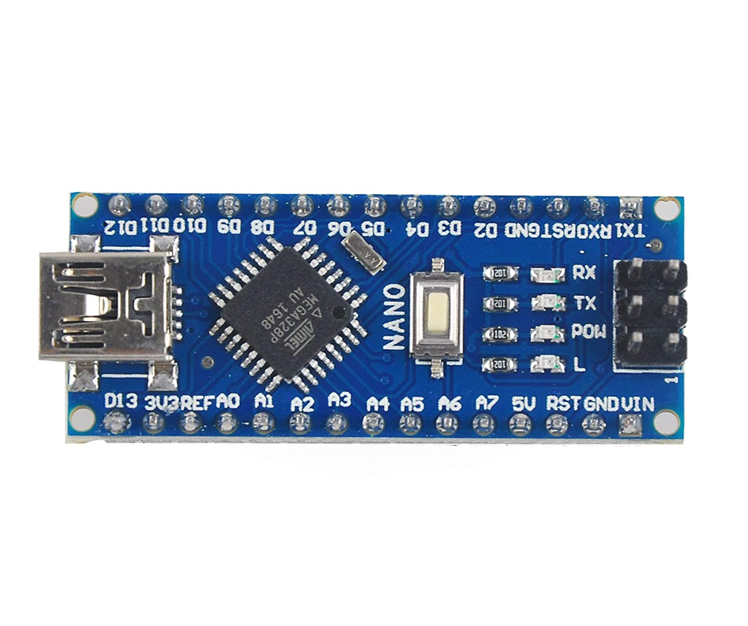
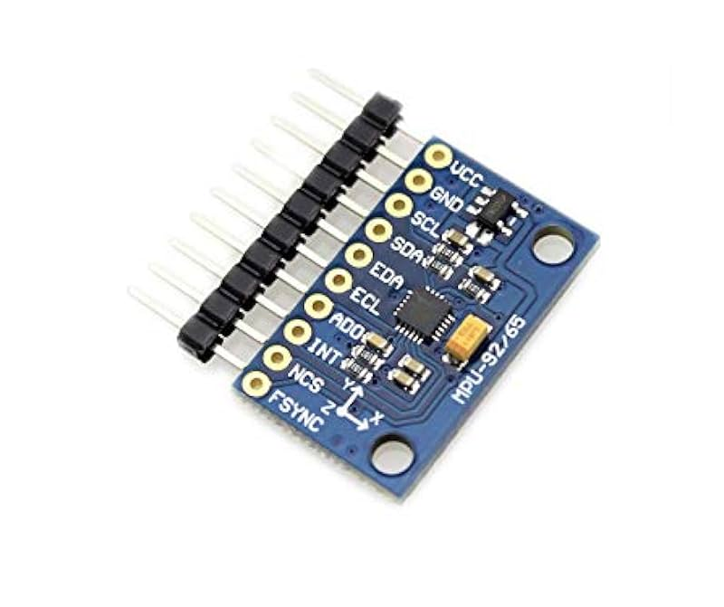
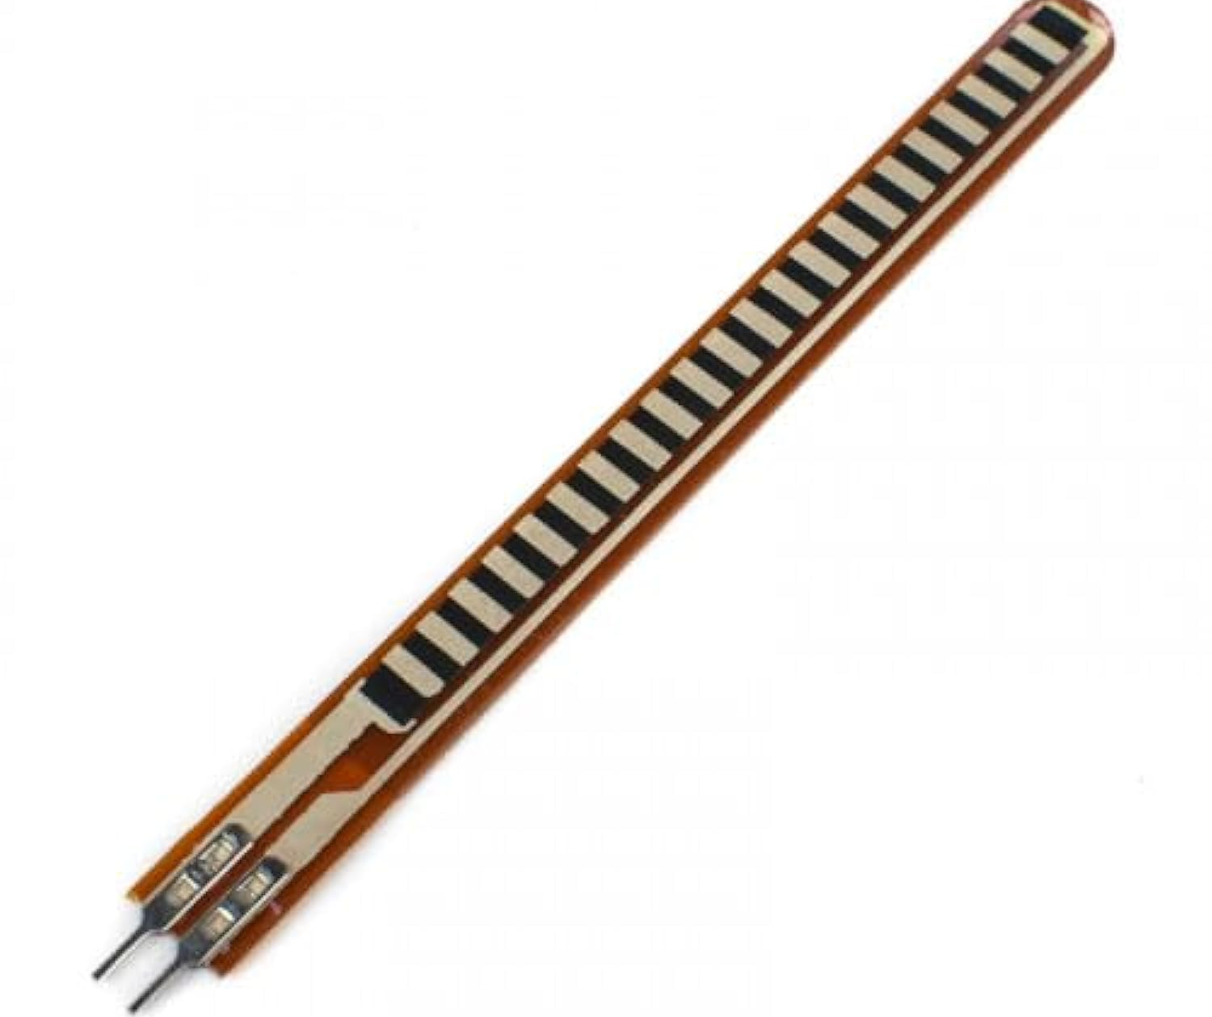
Glove components
Arduino Nano
MPU9250
Flex Sensor

Slide 8
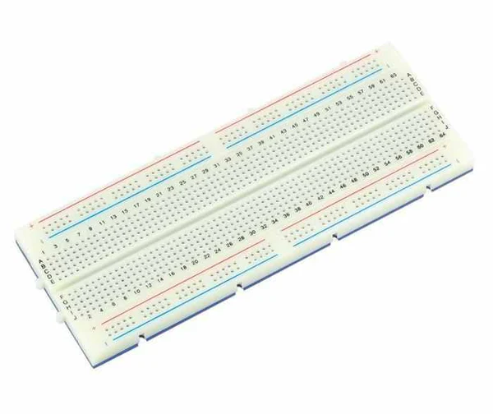
Glove components
Bluetooth module HC05
Jumper Wires
Bread Board

Slide 9
Circuit Diagram

Slide 10
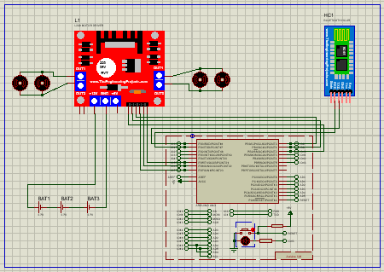
RC car circuit

Slide 11
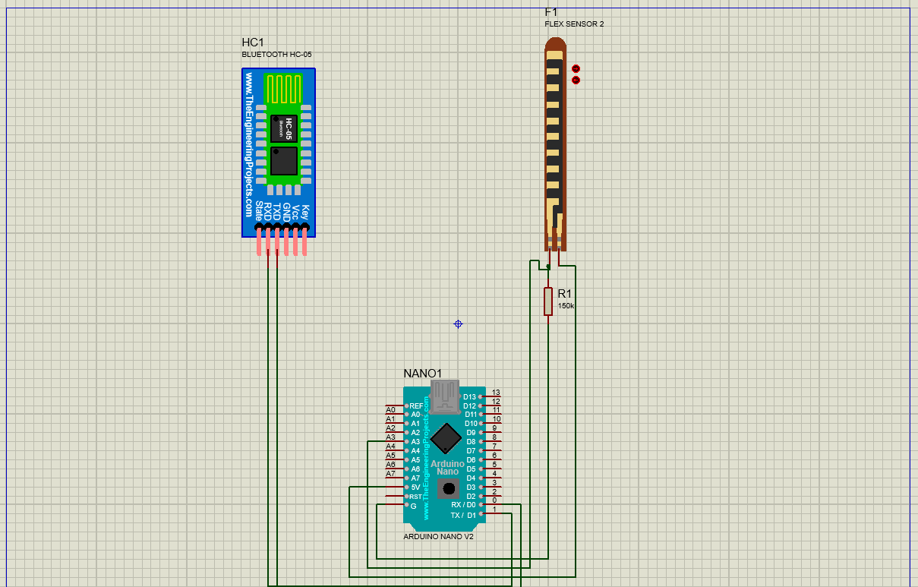
Glove Circuit

Slide 12
Code

Slide 13
Glove Code

Slide 14
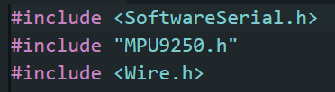
Libraries used
First one is for Bluetooth communication via UART.
Second one is used to get values from the MPU.
Third one is for the I2C communication that the MPU9250 works with.

Slide 15
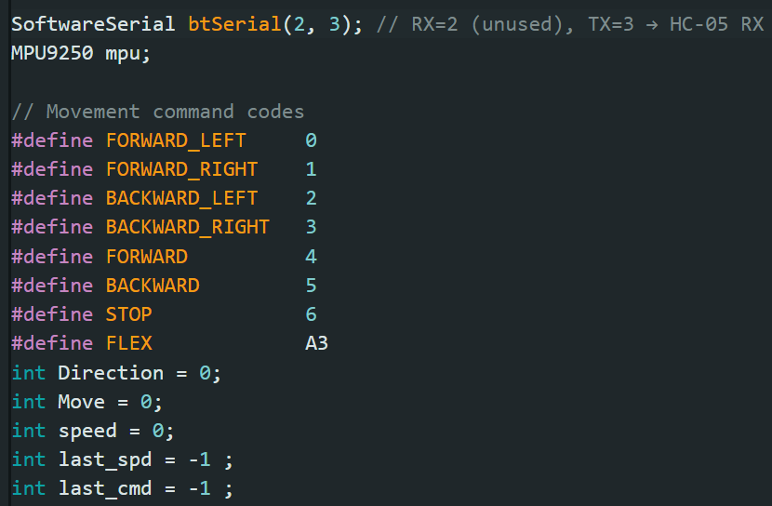
Initializations
Initializing UART and making MPU object for later use.
Initializing some macros that is used to send directions.
And some global variables to be kept always updated.

Slide 16
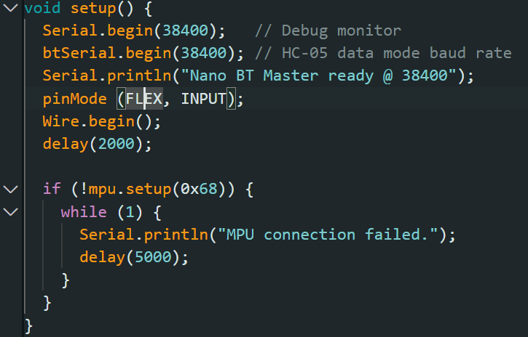
Setup()
The setup is rather simple and self explanatory. Everything is just getting initialized!

Slide 17
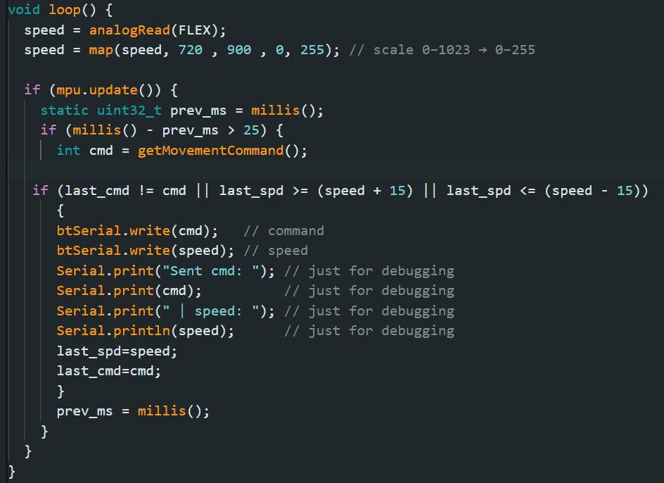
Loop()
Speed takes flex reading. And we mapped it from 0 to 255 for a certain reason coming later.
Every loop MPU gets updated with its new values.
cmd is used to get the movement direction command.
before sending we check if a new cmd has been recorded and also if speed got a new record with some sensitivity. If so then send it. If not then it returns and execute the loop from the start

Slide 18
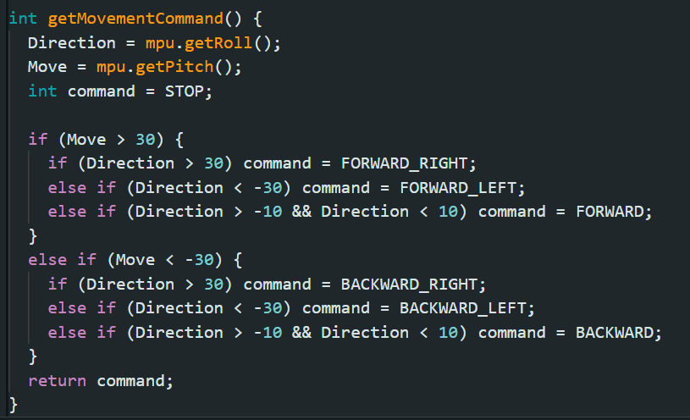
GetMovmentCommand()
This function is used to process the values coming of the MPU. Move is (forward-backward) and Direction is (right-left).
We initially set command as stop then check MPU values..
after the function deduced the outcome it returns the command to check upon the command if it changed or not. (we don’t want to send the same value continuously)

Slide 19
Car Code

Slide 20
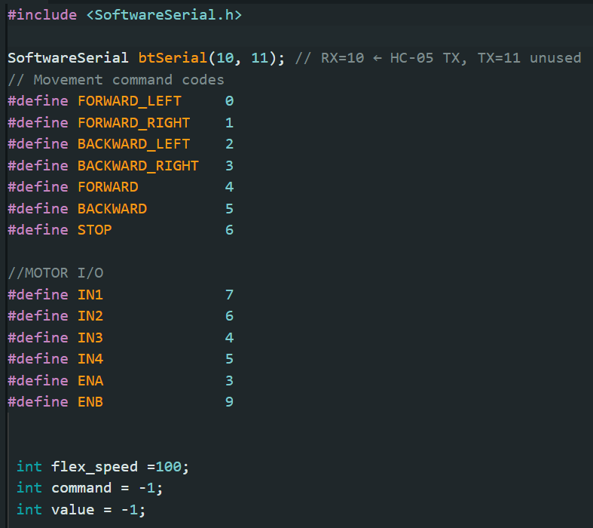
Libraries, macros, variables
Same stuff as the Glove code here but slightly different… the Receiver is controlling motor direction and speed too! So we made more macros!
flex_speed is for the sent flex value.
command is for the direction command.
value is where either the flex value or the command is stored in first.

Slide 21
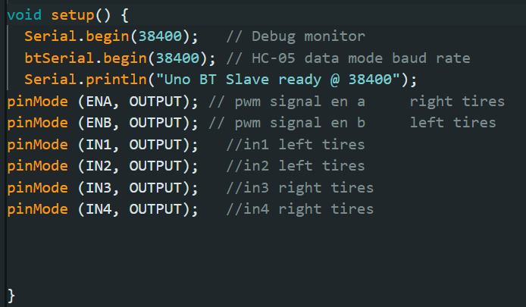
Setup()
Not much needed to be explained in the setup function… there are just some initializations.

Slide 22
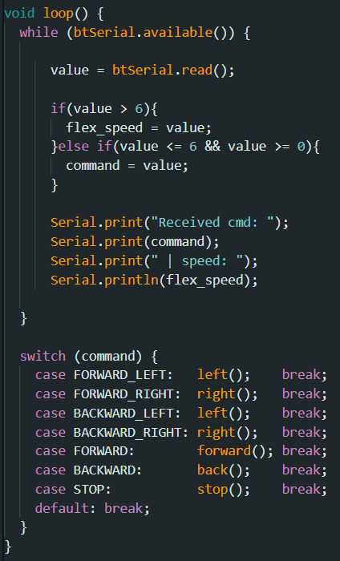
Loop()
Firstly.. Value takes whatever sent to it.. We check if the value is larger than 6, then it is a flex sensor value.. If not then the other condtion is true and it’s a command! (command macros are from 0-6)
After storing the command we check the command in a switch statement.. And execute the corresponding command.

Slide 23
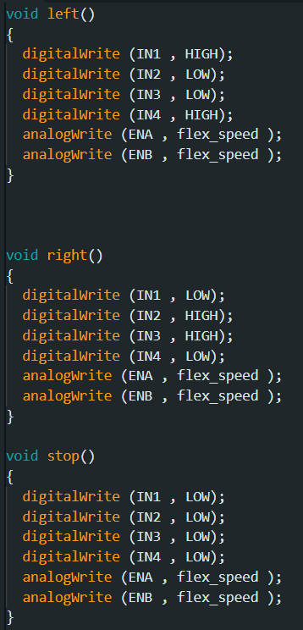
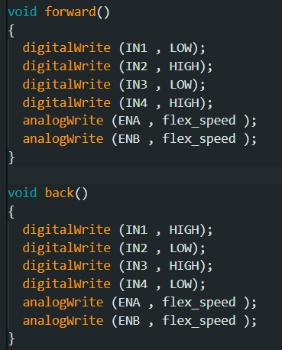
Movement functions
These are the functions that controls the direction and speed of the car motors.

Slide 24
Git Hub

Slide 25
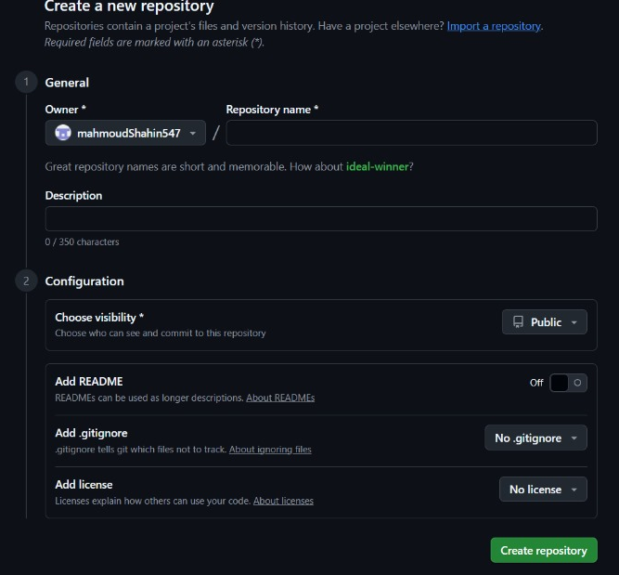
First of all, we had to create a new repository so that we can put our files and work in , so we got into the GitHub.com site , and had the following page loaded up where we got to put our project name (Repository name), the description of the project, and chose its visibility to be public so that everyone would have the access to the repository

Slide 26
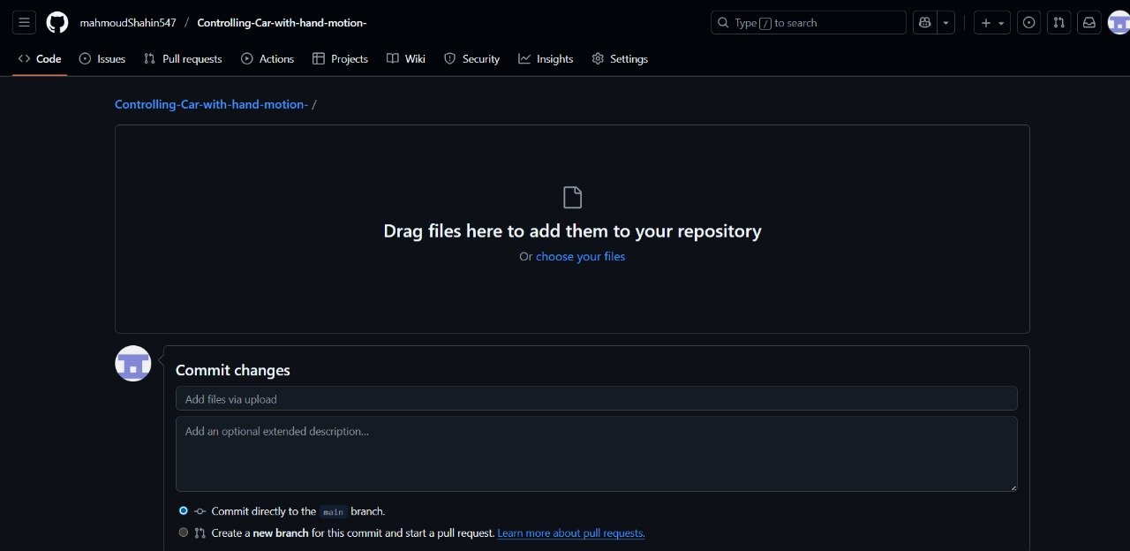
Then we had to upload our files to the repository so we dragged them after we finished them and uploaded them here.

Slide 27
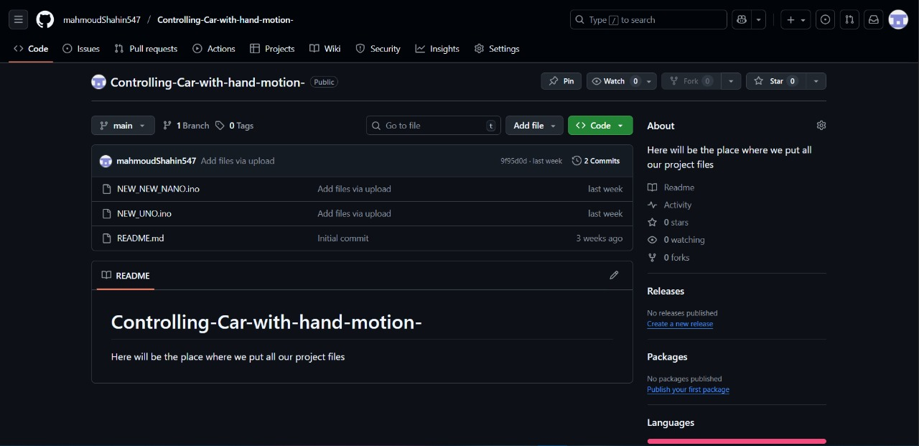
and last but not least this was our repository after uploading our files.

Slide 28
Github link
https://github.com/mahmoudShahin547/Controlling-Car-with-hand-motion-

Slide 29
Flowchart

Slide 30
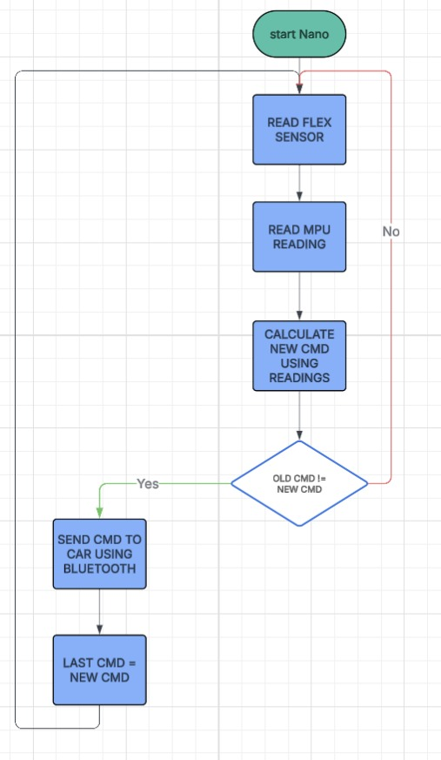

Slide 31
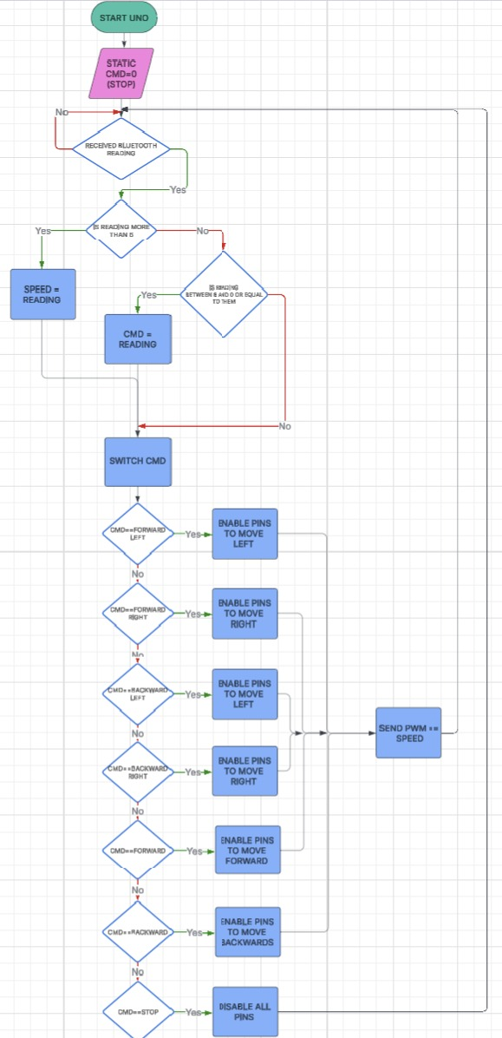

Slide 32
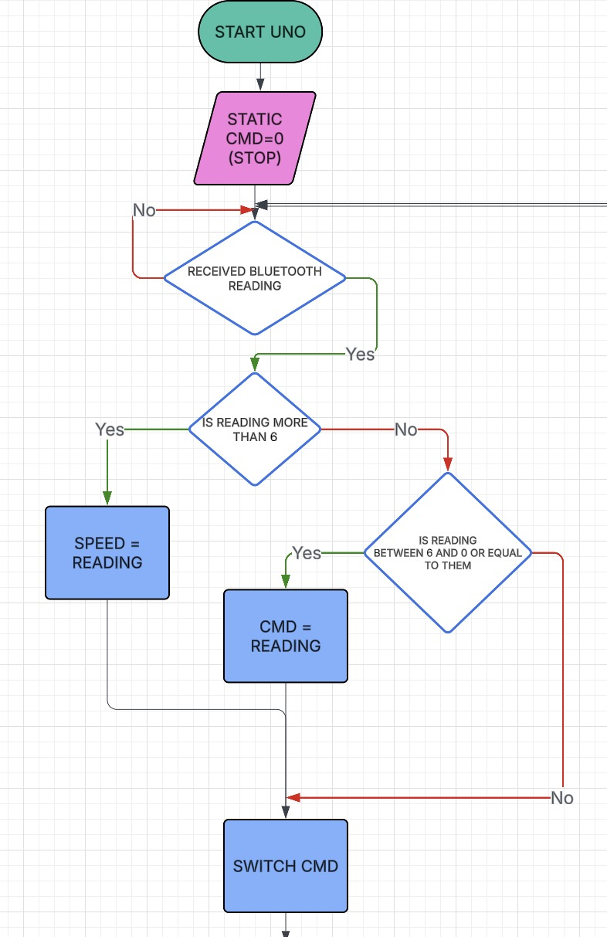

Slide 33
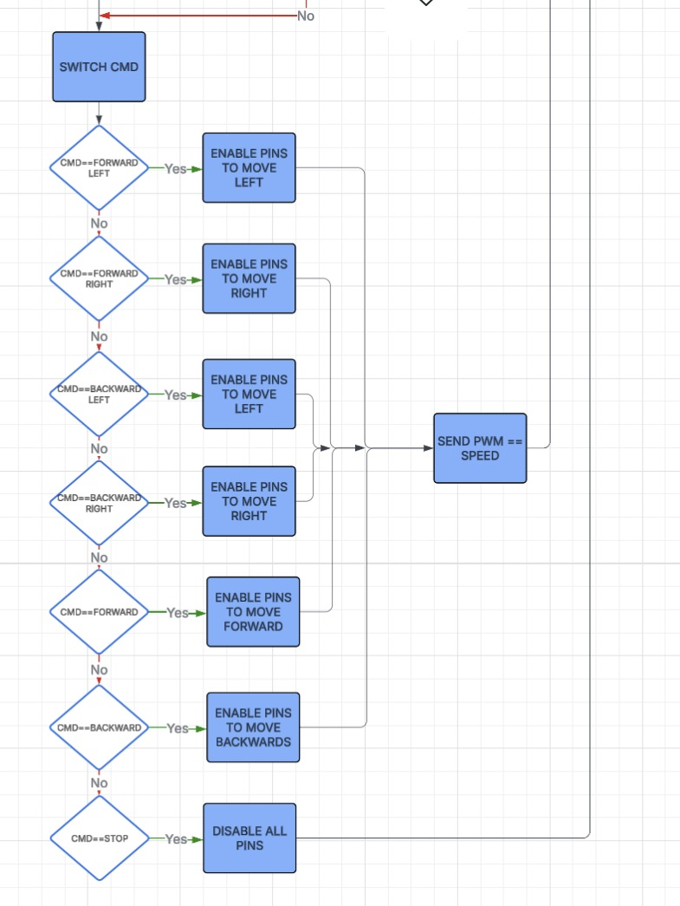

Slide 34
Team Members
FARES SAKR
Yahia Nabil
Mahmoud Shahin
Yousef Assar
Basant Hagag

Slide 35
THANKS

